Slide 1
Project on analytics

Slide 2
Part-2
Task one
Task two​
Task three
Task four

Slide 3


Introduction about problem statement
Nitin works as a Graphic Designer I a new company. He earns Rs. 15,000/- per month. He is planning to buy a scooter for his daily commute to the office.
For the last couple of months, Nitin is not able to save at all for his scooter. His friend Ayush told him that he needed to figure out where most of the money goes and cut down that expense.
Help Nitin increase his savings by removing some unnecessary expenses.

Slide 4
Task one
Member 1
Month-wise trend of expenses (Pivot table and chart)
Find out the month Nitin spent the most

Slide 5
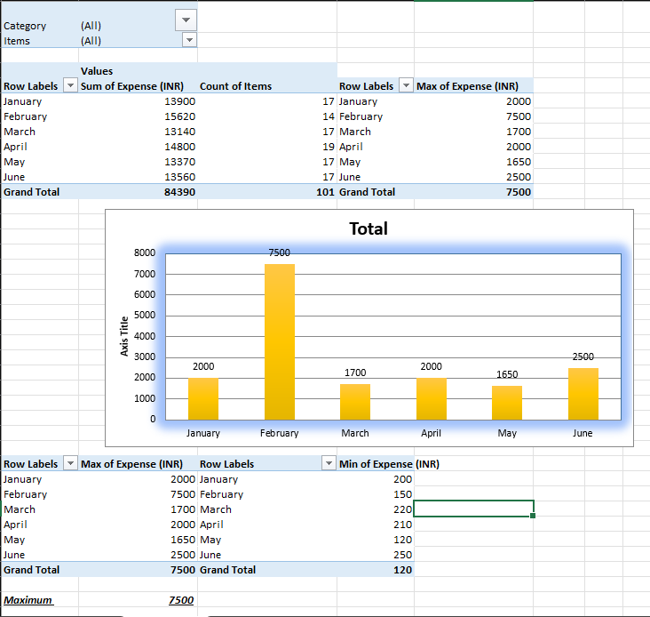
Member 1 Month-wise trend of expenses (Pivot table and chart) Find out the month Nitin spent the most

Slide 6
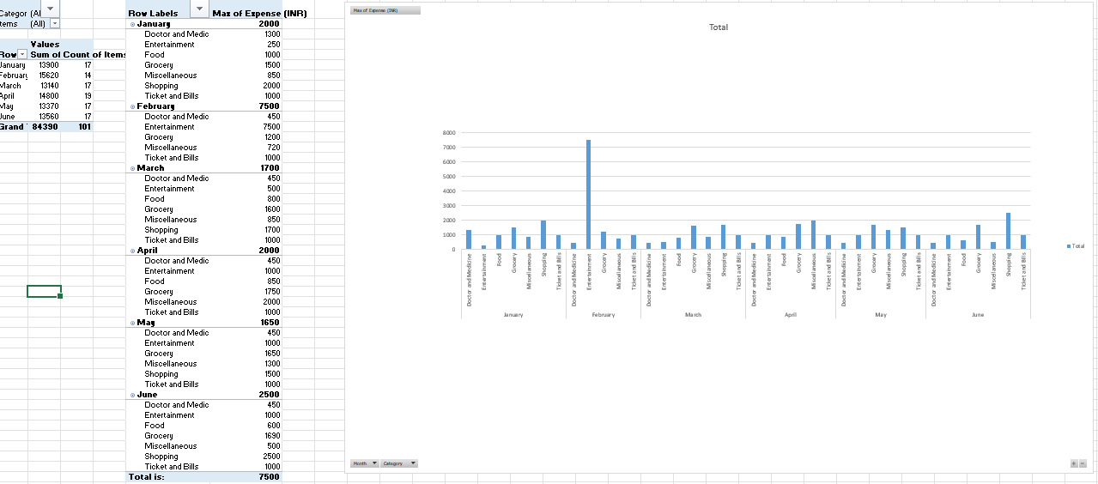
Chart

Slide 7
Task two
Member 2
Category wise expenses (Pivot table)
Visually represent it with data bars to display categories with the highest and lowest expense amount

Slide 8
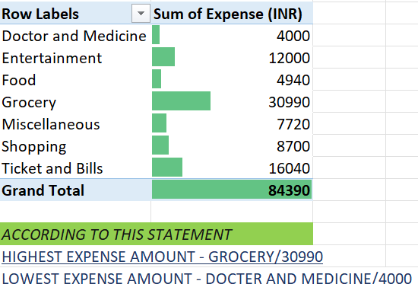
table

Slide 9
Task three
Member 3
Month-wise expense of each category (Pivot table)
Find out 2 categories with higher expenses for each of the 6 months

Slide 10
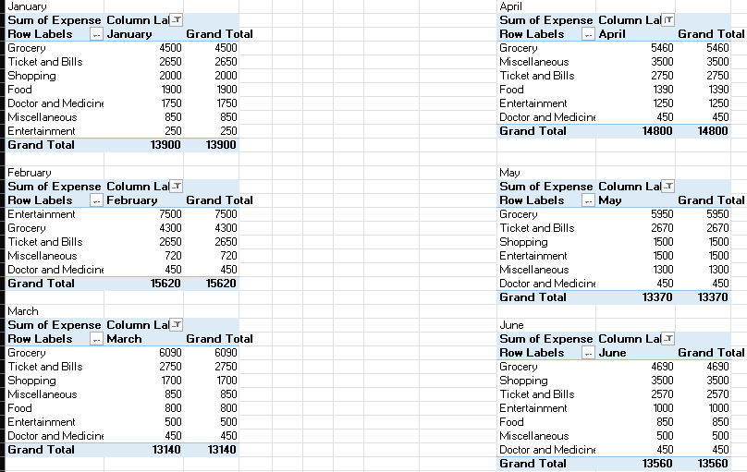
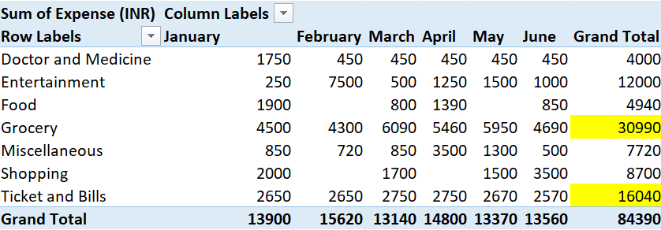
table

Slide 11
Task four
Member 4
How much is spent in each month against different items of Entertainment, Food and Shopping categories (Pivot table)
Find out which months have the highest amount spent for movies and dining out

Slide 12
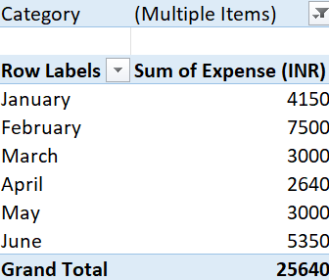
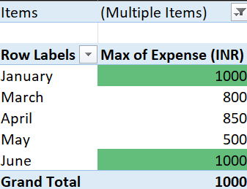
Table

Slide 13
Task for all
All
Decide on the essential and less essential items and analyze the expenses
Recommend how can Nitin increase his savings

Slide 14
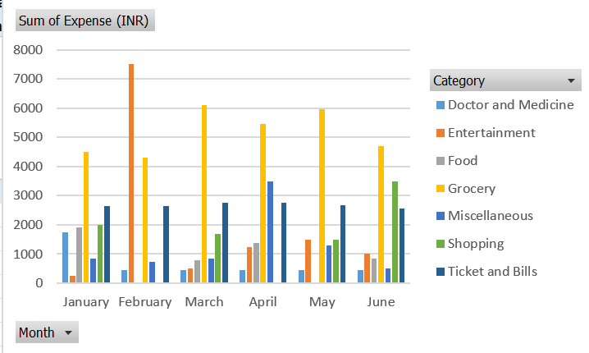
Decide on the essential and less essential items and analyze the expenses
Based on the provided expense data, we can categorize items as follows:
Essential Expenses
Doctor and Medicine: Crucial for healthcare needs.
Food: Necessary for sustenance.
Grocery: Includes essential food items and household staples.
Ticket and Bills: Covers utilities, transportation, and other necessary payments.
Less Essential Expenses
Shopping: Discretionary spending on non-essential items.
Entertainment: Leisure activities and hobbies.
Miscellaneous: Uncategorized expenses that are generally not necessary.

Slide 15
Recommend how can Nitin increase his savings
Reduce Non-Essential Spending:
Limit Snack Purchases: Consider home-cooked alternatives or healthier options.
Cut Down on Dining Out: Prepare meals at home to save money.
Entertainment Budget: Set a monthly limit for entertainment expenses.
Optimize Essential Spending:
Grocery Shopping: Explore bulk buying, coupons, and generic brands to reduce costs.
Utility Bills: Consider energy-saving measures and compare different service providers.
Transportation Costs: Evaluate public transport options or carpooling to reduce fuel expenses.
Create a Detailed Budget:
Categorize Expenses: Break down expenses into specific categories for better tracking.
Set Spending Limits: Assign budgets to each category based on income and financial goals.
Monitor Spending: Regularly review expenses to identify areas for improvement.
Increase Income:
Explore Side Hustles: Consider part-time jobs or freelance work to supplement income.
Upskill: Enhance skills to qualify for higher-paying jobs.
Invest Wisely: Explore investment options to grow savings.
Automate Savings:
Set Up Automatic Transfers: Dedicate a portion of each paycheck to a savings account.

Slide 16

TEAM-4
Sneha Singh
Leader
Nikita Vishwakarma
Member
Nipun Parashar
Member
Saurabh Singh
Member
Siddhant Tandon
Member
Arindam Mukherjee
Member

Slide 17
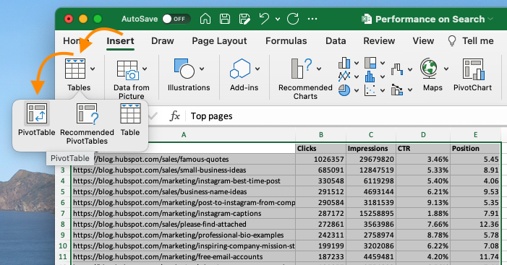
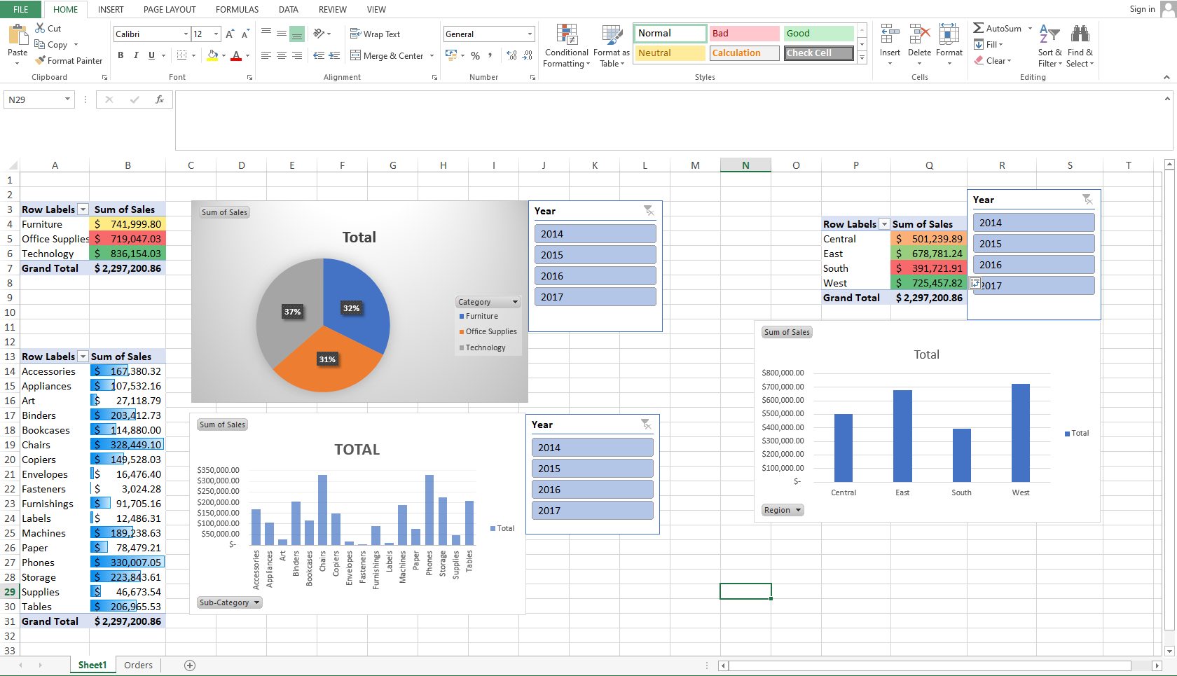
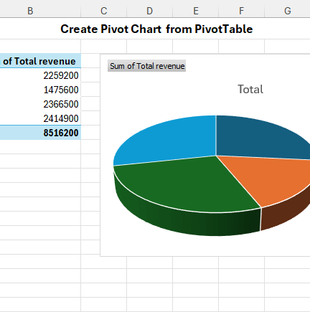
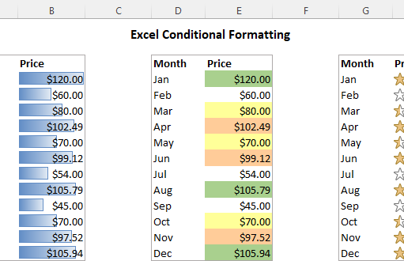
Summary of pivot table, pivot chart & conditional formatting
Pivot Tables
Purpose: Summarize and analyze large datasets by organizing, exploring, and presenting information.
Key components: Rows, columns, values, and filters.
Functionality:
Group and aggregate data based on different criteria.
Calculate sums, averages, counts, and other statistical measures.
Create dynamic reports that can be easily modified and refreshed.
Drill down into data for detailed analysis.
Pivot Charts
Purpose: Visualize data from a pivot table.
Relationship to Pivot Tables: Dynamically linked to the underlying pivot table, so changes made to the pivot table are reflected in the chart.
Types: Various chart types (bar, line, pie, etc.) can be used to represent data effectively.
Conditional Formatting
Purpose: Apply specific formatting to cells based on certain conditions.
Functionality:
Highlight cells based on values (greater than, less than, between, etc.).
Use data bars, color scales, and icon sets for visual emphasis.
Create custom rules for complex formatting scenarios.
Can be applied to both regular data ranges and pivot tables.

Slide 18
Thank you

